Slide 1
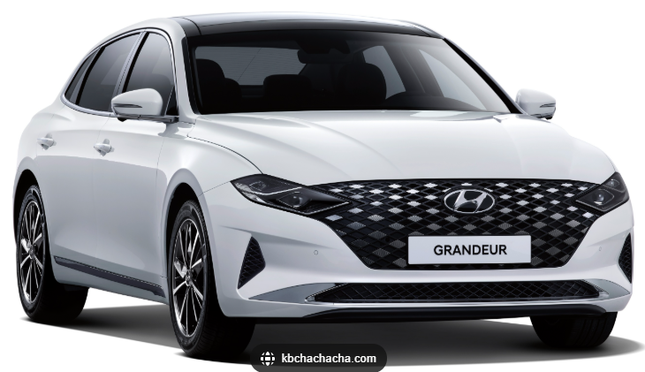
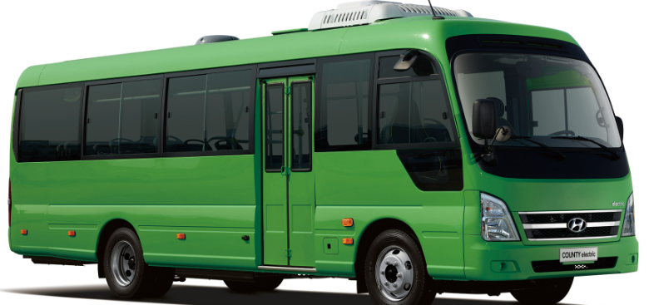
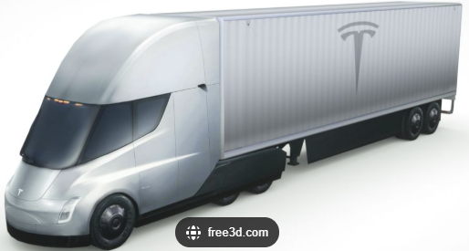
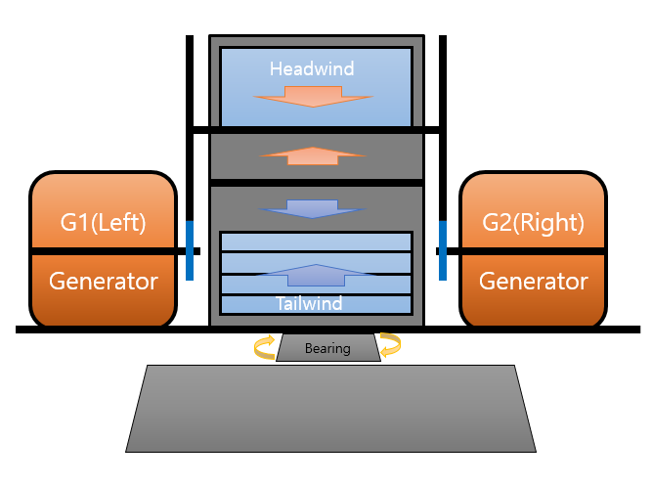
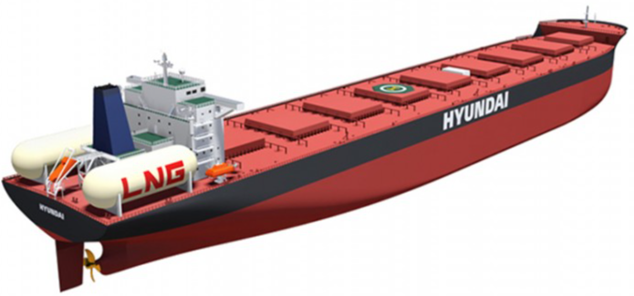
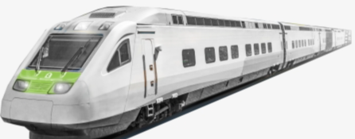

Wind energy scales with the cube of wind speed, and when efficiently harnessed,
It can enable a future of mobility that requires no external charging beyond self-generation.
The system captures frontal airflow for centrifugal
power generation and controlled exhaust to
minimize drag, with a single central turbine and
Symmetrically positioned side generators provide
stable, tip-free operation.
Multi-Stage Compressed Dual-Flow
Wind Turbine Generator
(Single-Turbine Dual-Generator System)

Slide 2

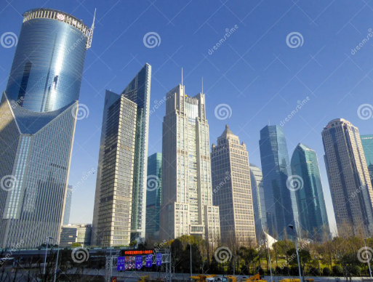
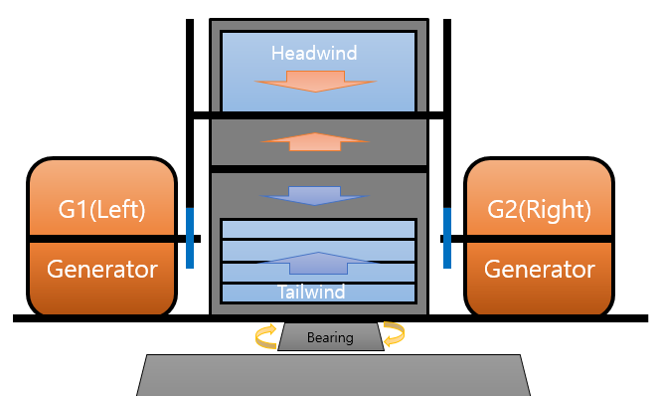
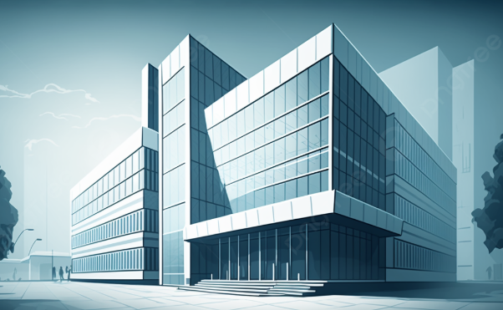
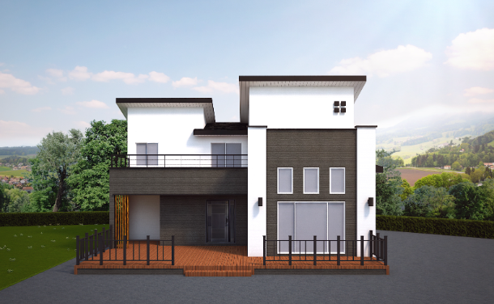
It can be installed on the roof of a building as it eliminates vibration and noise.
Roadsides will no longer require utility poles or overhead power lines.
Battery charging
delivery station.
(Rechargeable Battery Delivery)

Slide 3
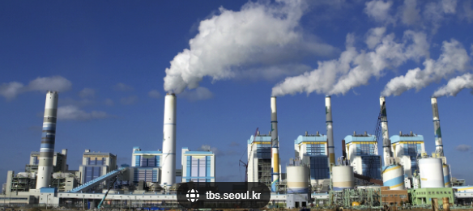
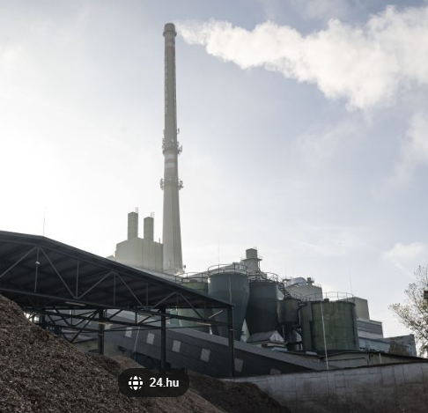
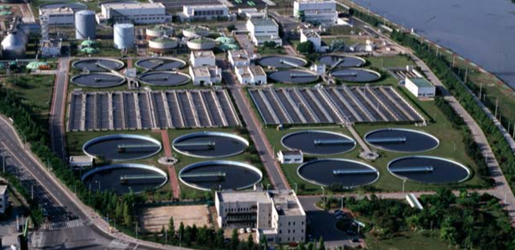
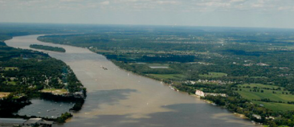
Thermal power plant
Incineration plant
All-purpose turbine generator for wind,
hydropower, and thermal power applications.
The universal turbine generator enables
a new era of water reuse.
This is a multi-purpose turbine generator
applicable to wind, in-stream hydropower,
tidal energy, and thermal steam systems,
enabling simultaneous power generation,
seawater desalination, waste-heat utilization,
and wastewater treatment with water reuse.
Wastewater treatment plant
The Mississippi River

Slide 4
